Slide 1
Flutter Workshop
Instituto Superior Técnico – 13/05/2025

Slide 2
Workshop
0
Presentation + Purpose
1
Hello “Mobile” World
2
What the Flutter?
3
How Flutter works?
4
Hands-on App creation

Slide 3
0
Presentation + Purpose

Slide 4


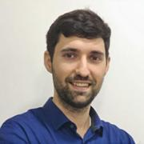

Presentation
Mobile Developer
Mobile Developer
Talent Wizard
João Ramalho
Sérgio Andrade
Beatriz Paixão
Notes:
Breve apresentação de toda a gente
dizer objectivo deste workshop

Slide 5



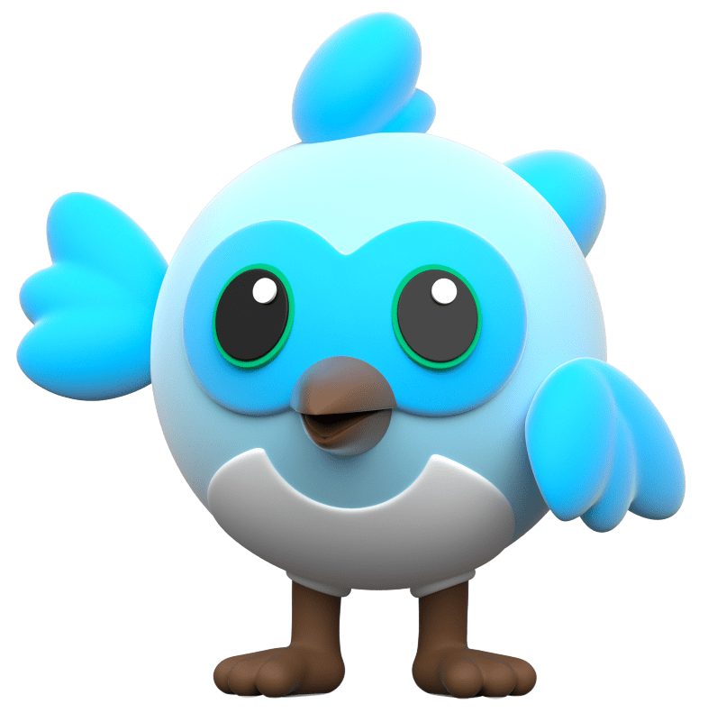
Purpose
Give Mobile context
Present Flutter World
Explain why we use Flutter
Know how to code in Flutter

Slide 6
1
Hello “Mobile” World
Brief History of the Mobile development

Slide 7
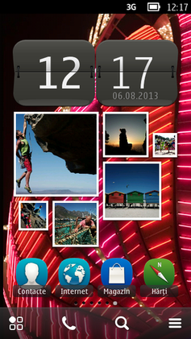
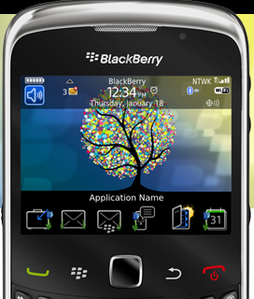
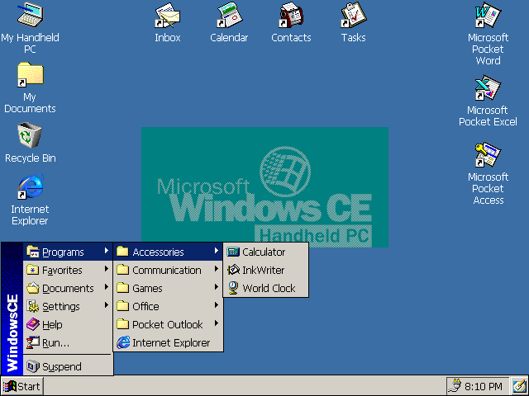



Pre-iOS
Symbian OS
BlackBerry OS
Windows CE
1997-2012
1999-2013
1996-2013
Notes:
A razão porque metemos Pre-iOS porque quando o iOS surgiu causou uma disrropção no mundo do mobile devido a grande usabilidade que o sistema operativo dava aos utilizadores.
Antes do iOS aparecer, os telemoveis estavam a ficar cada vez mais compactos e mais poderosos ao ponto de ser necessário um sistema operativo de janelas. Os que temos aqui na tela são 3 exemplos, o Symbian OS utilizado pela Nokia, Ericsson, Samsung, Motorola; BlackBerry Os usado pelo Blackberry e o Windows CE que estava presente em portateis e pda não tendo nenhuma marca associada.
Em 2005, Steve Jobs estava a planear iPhone “Encolher o Mac ou aumentar o iPod”. Apple viu uma grande oportunidade de explorar o mercado do telemoveis e com isso apareceu o primeiro iPhone e por sua vez iOS em 2007. Este teve uma igual adesão o que representava sarilhos ao Symbian OS e ao BlackBerry OS. Antes do surgimento do iOS, uma equipa estava a trabalhar num OS que tinha como foco os devices com touchscreen, leve e que fosse possivel que instalar em qualquer dispositivo movel, e em 2008 surgiu o AndroidOS. Devido ao kernel de linux e ser um open source, consegue os seus objectivos.

Slide 8






What is Native?
2008
2007
Notes:
Inicialmente a Android pegou na linguagem do Java por ser uma das linguagens mais utilizadas mundialmente.
Problemas:
A Oracle processou a Google por alegada violação de direitos de autor ao usar APIs Java no Android.
Por causa disso, a Google começou a desenvolver uma linguagem mais apropriada para o Android, dai ter surgido o Kotlin.
Aumentou a produtividade e performance, com menos codigo e mais moderno e seguro.
A colaboração entre Google e JetBrains.
Facil de migração
Quando Steve Jobs saiu da Apple, ele fundou a empresa NeXT aonde desenvolveram a linguagem Objective-C, Foundation e AppKit para o seu OS. A Apple comprou a NeXT, com isso o Objective-C tornou-se a linguagem principal de desenvolvimento da Apple e Steve Jobs voltou como “conselheiro especial” e depois como CEO. Ao passar do tempo, a linguagem tornou-se demasiado verbose e complexa para o seu objectivo, com esse objectivo apareceu o Swift e foi uma transformação gradual.

Slide 9
Native Heaven & Hell
Important:
The need to have two teams
Double the cost of the company
Not ready to be implemented in one of the OS
Hard to maintain two repositories
Notes:
São mais rápidos a desenvolver e tem sempre novas atualização.
A Google está a apoiar fortemente esta Framework.
Facilmente sabem o que se passa com Android.
iOS pode ser adaptado no futuro.

Slide 10




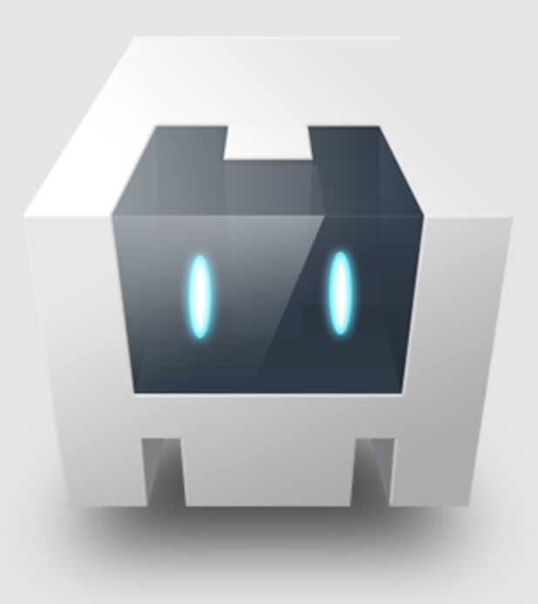
Cross Platform Languages – Hybrid Languages
PhoneGap
Ionic
ReactNative
Xamarin
Cordova
Notes:
Here comes a new challenger

Slide 11
2
What the Flutter?
What is? Why we use it?

Slide 12


What the Flutter?
What?
Framework open-source created by Google.
Why?
Easy to understand, everything is adaptable, everything is a widget, native behaviour and one code to rule them all
Who supports?
Google but most importantly a big and healthy community. Where they can easily add/change code/libs.

Slide 13
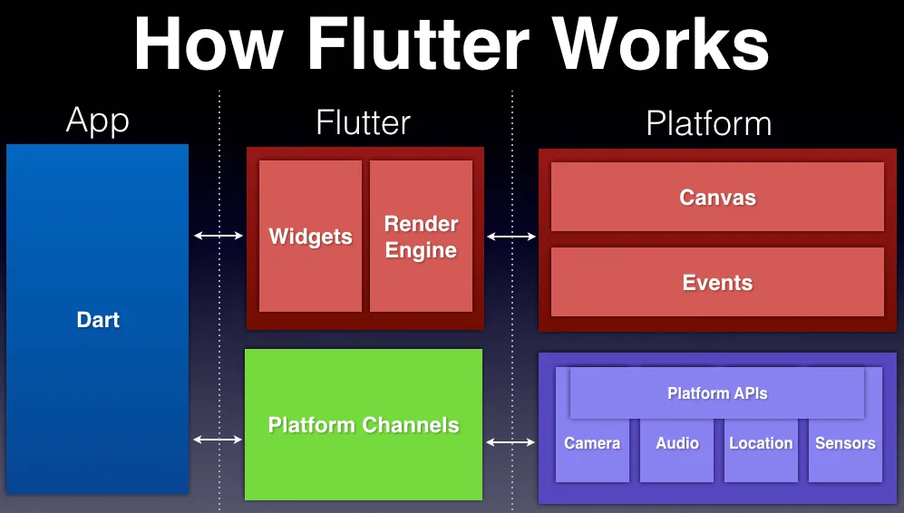
How Flutter works?
Notes:
Responsabilização dos widgets e das ligações nativas.
Tudo o que têm Platform APIs tem de funcionar para todos os OS
Não tens webviews
A única coisa que tens de preocupar é OS
Platform Channels conseguem abstrair os OS p.e. android 15 e iOS 10
Tem os seus proprios componentes.
• Criaram o seu próprio Render Engine que permite correr as aplicações atingindo uma performance quase similar ao nativo.

Slide 14


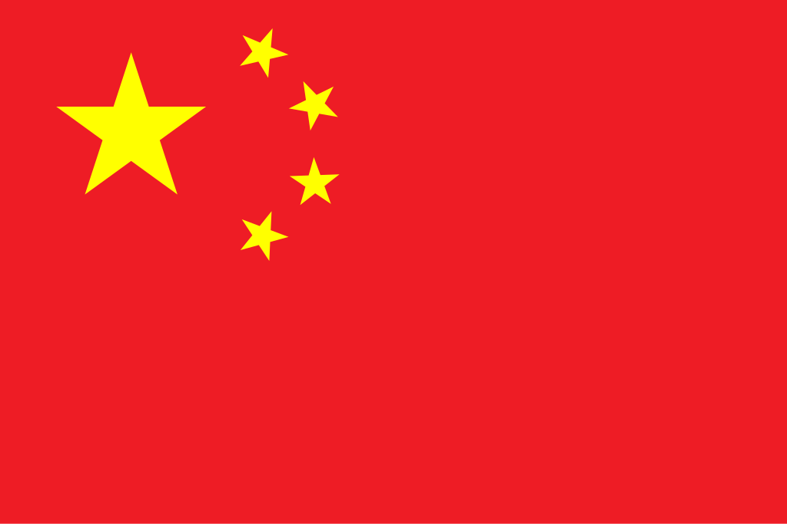

Why we use Flutter?
Important:
Trustworthy for having only one codebase
Same features in every app for every OS.
OOP Pillars
Clean Architecture
Unit tests

Slide 15
3
How does Flutter works?
Structure, Widgets, State Managers

Slide 16

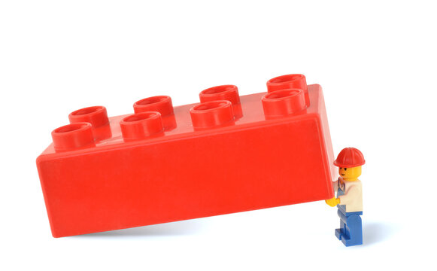
Flutter’s Base Structure
Scaffold
Widget
Notes:
Pegando no que foi dito que everything is a widget, quando nos desenvolvermos um ecrã, metemos sempre um tapete verde onde podemos meter outros widget em cima desse tapete.
Esse Widget pode possibilitar adicionar outro widget por cima dele.

Slide 17
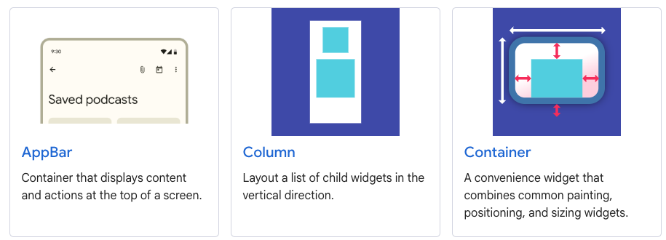
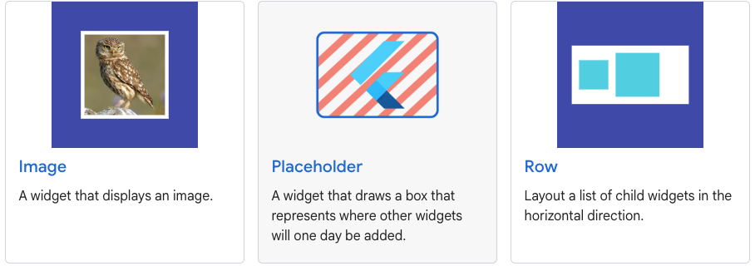
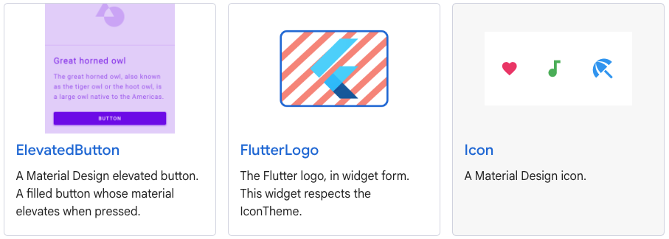
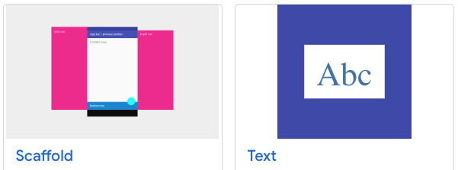
Widgets And Widgets

Slide 18



State Manager
Tool that allow to control/track the state of an app and update the UI
Provider
BLoC
Riverpod
Statefull Widget

Slide 19
4
Hands-on App creation
How to create a Flutter App from zero

Slide 20
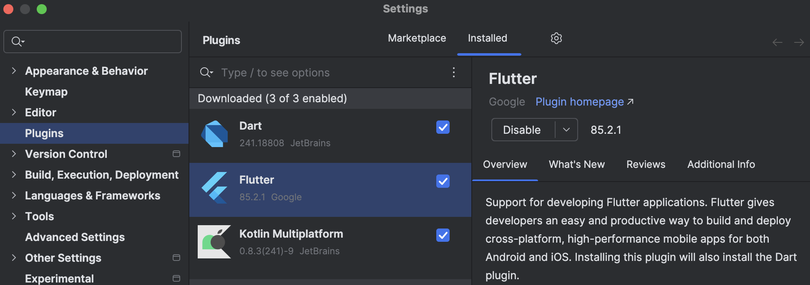
Preparing the Project
Before you start, make sure you have the Dart and Flutter plugins installed

Slide 21
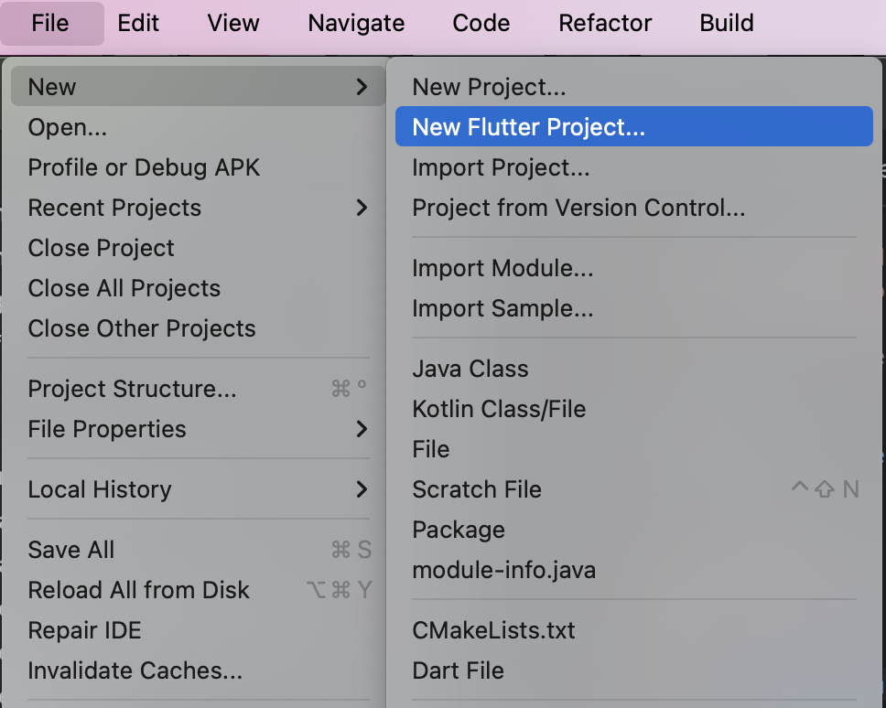
Create new Project
To start, on Android Studio:
Then, on the Generators select Flutter and press Next.
Now just give it a nice Project Name and, optionally, set the Organization to something unique.
All set!

Slide 22
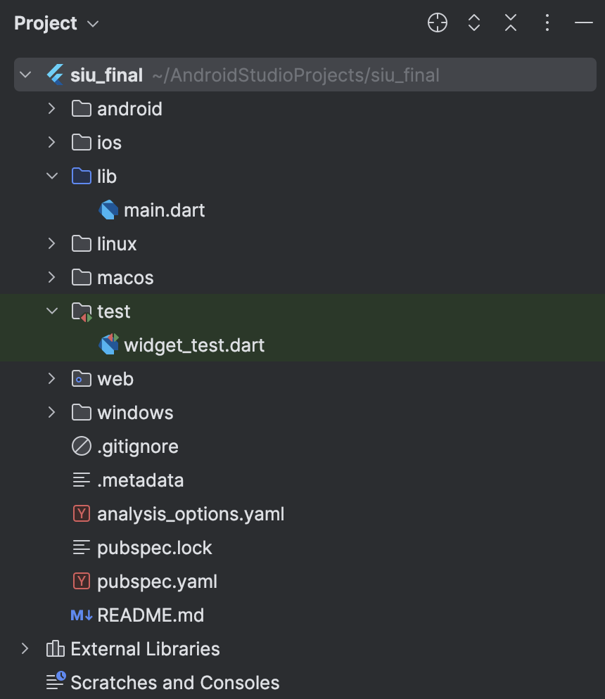
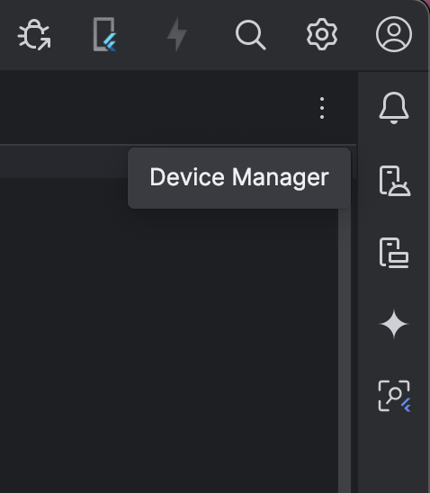
Uh – What's this?
Important:
-main.dart
-test directory
-pubspec.yaml
-pubspec.lock
-analysis_options.yaml
Create an Emulator:

Slide 23
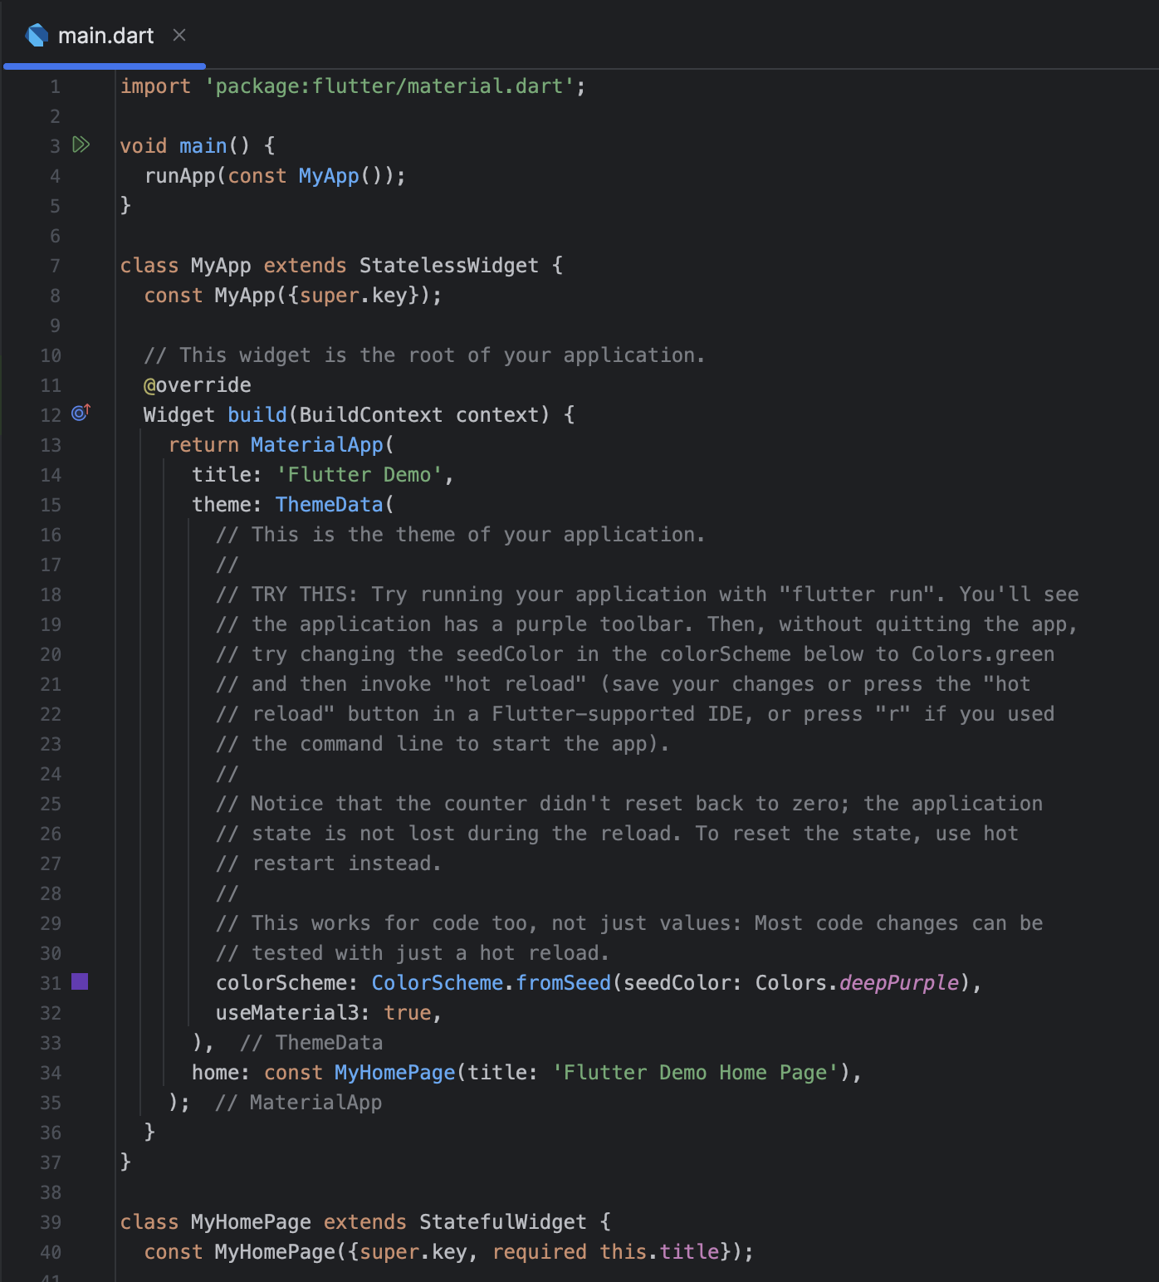
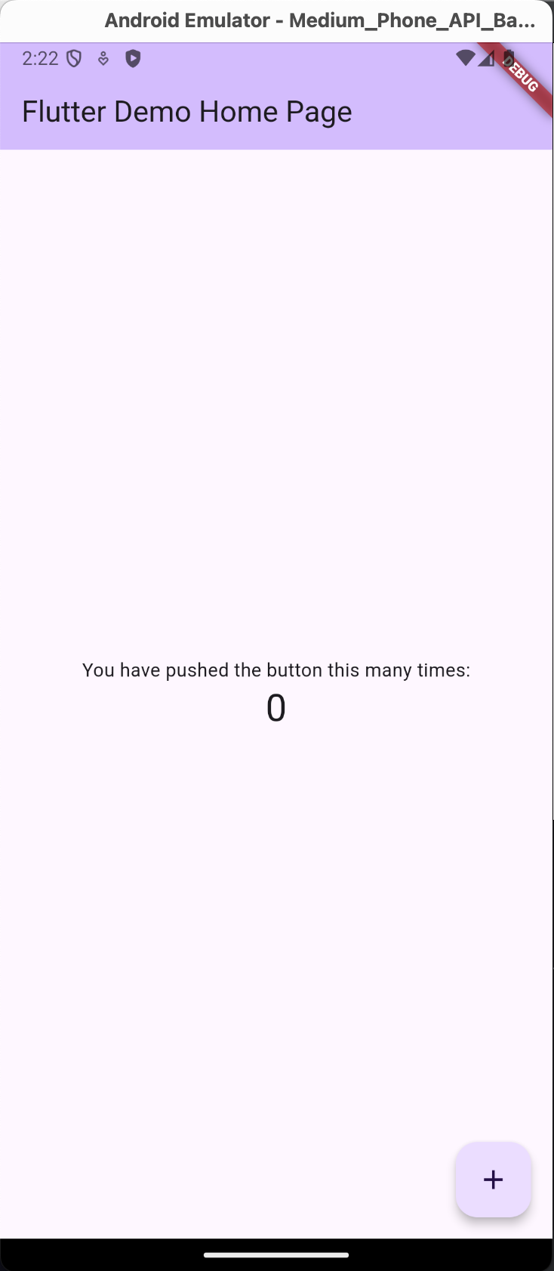
Main class & running the Project
To run the Project:

Slide 24
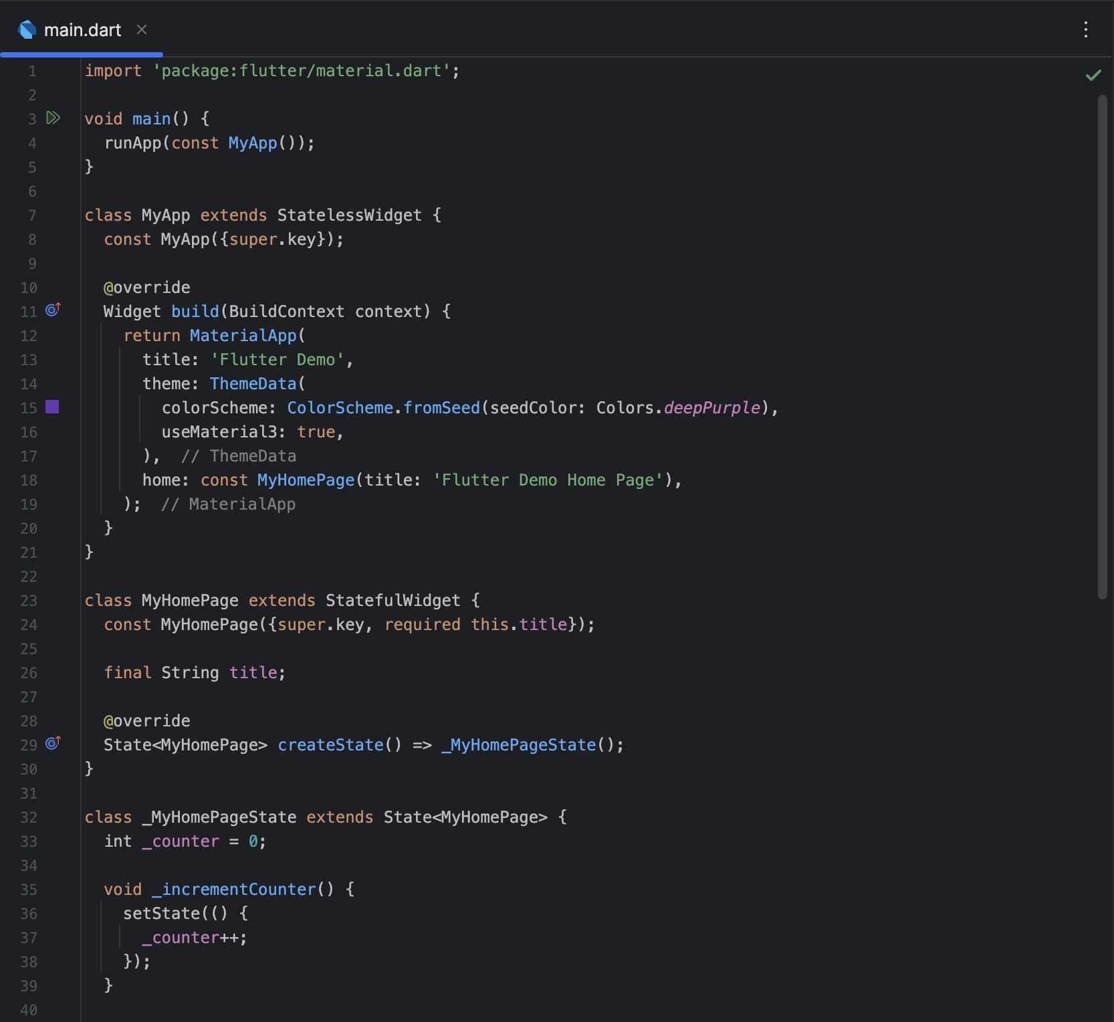
All are widgets! Everything is permitted.
Important:
-Read comments on main.dart
-Widgets
-Stateless & Stateful widgets
-Hot Restart & Hot Reload
-SetState()
-build method
-Scaffold & nesting widgets
-BuildContext

Slide 25
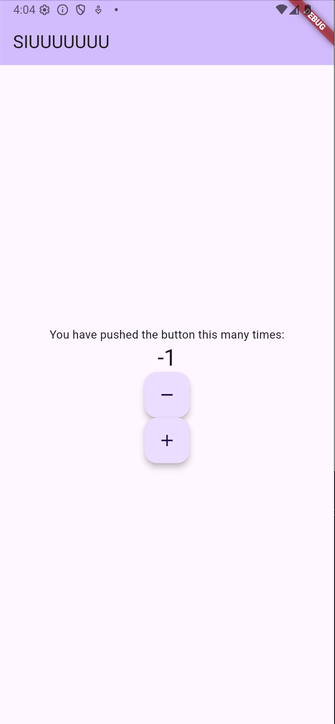
SIUUUUUU page - Buttons
Change the Page title (AppBar title):
home: const MyHomePage(title: 'SIUUUUUUU'),
Remove the widget FloatingActionButton from the Scaffold and insert in Column:
FloatingActionButton( onPressed: _incrementCounter, tooltip: 'Increment', child: const Icon(Icons.add), ),
Create a Decrement Counter:
FloatingActionButton( onPressed: _decrementCounter, tooltip: 'Decrement', child: const Icon(Icons.remove), ),

Slide 26
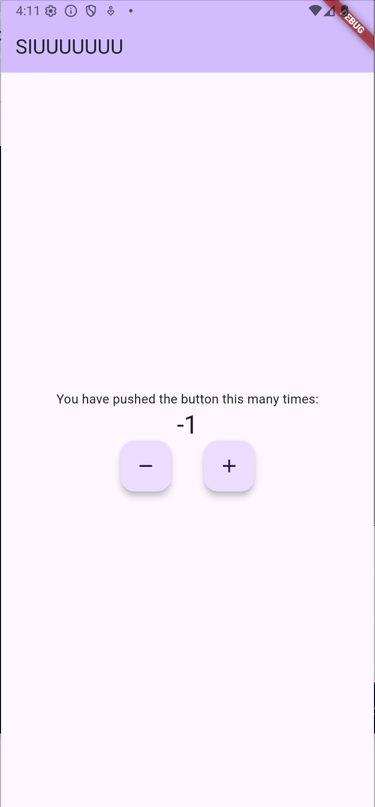
SIUUUUUU page – Columns, Rows & SizedBox
Create a Row to house the 2 buttons:
Row( mainAxisAlignment: MainAxisAlignment.center, children: [ FloatingActionButton( onPressed: _decrementCounter, ... ), const SizedBox( width: 36, ), FloatingActionButton( onPressed: _incrementCounter, ... ), ], ),

Slide 27
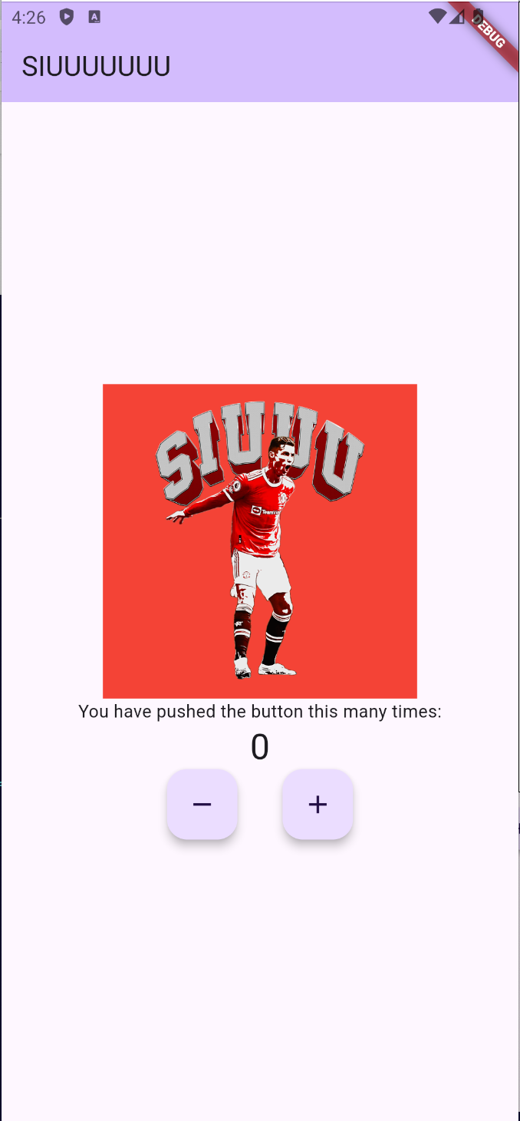
SIUUUUUU page – Container, Image & Semantics
Create a Container to house the Image:
Container( color: Colors.red, width: 250, height: 250, child: Image.network( "https://images.fineartamerica.com/images/artworkimages/medium/3/cristiano-ronaldo-siuuu-celebration-goal-kirania-finest-transparent.png", ), ),
Add Semantics as a parent of the Container:
Semantics( value: "Cristiano Ronaldo goes SIUUUUUUUUU on us all.", child: …
),

Slide 28
SIUUUUUU page – Animations & Rotation; Mixin
Create Animation and AnimationController:
Animation<double> _setAnimation() { AnimationController controller; Animation<double> animation; controller = AnimationController( vsync: this, duration: Duration(milliseconds: _calculateVelocity()), ); animation = Tween<double>( begin: 0, // Start rotation angle end: (2 * 3.141), ).animate(controller);
controller.repeat(); return animation; }
Extende mixin:
with TickerProviderStateMixin
Calculate Velocity method:
int _calculateVelocity() { const defaultVelocity = 10000; var acceleration = 1000 * _counter.toInt(); if (acceleration >= defaultVelocity) { acceleration = defaultVelocity - 100; } return defaultVelocity - acceleration; }

Slide 29
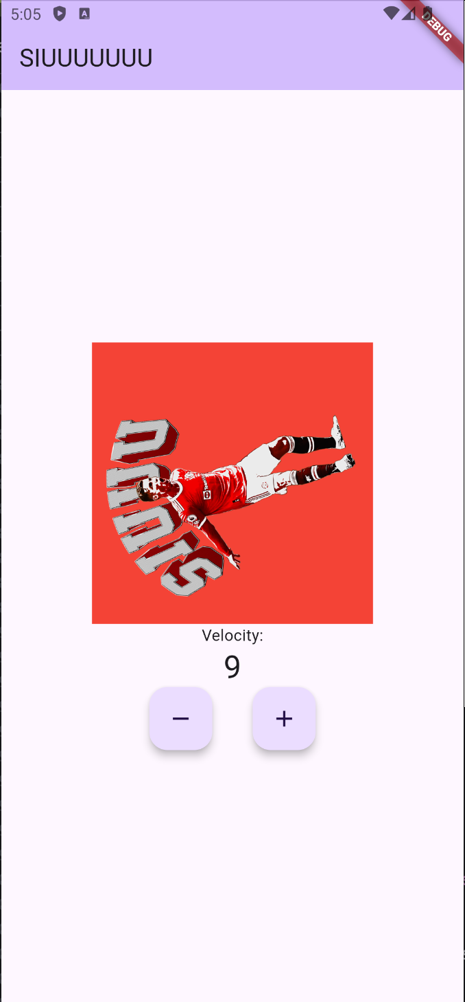
SIUUUUUU page – AnimatedBuilder
Wrap the Image with an AnimatedBuilder and a Transform to rotate image:
AnimatedBuilder( animation: animation, builder: (context, child) { return Transform.rotate( angle: animation.value, child: Image.network(... ), ); }, ),
Add the animation setup to the build:
final animation = _setAnimation();
Exercise: Remove skip when changing speed.

Slide 30
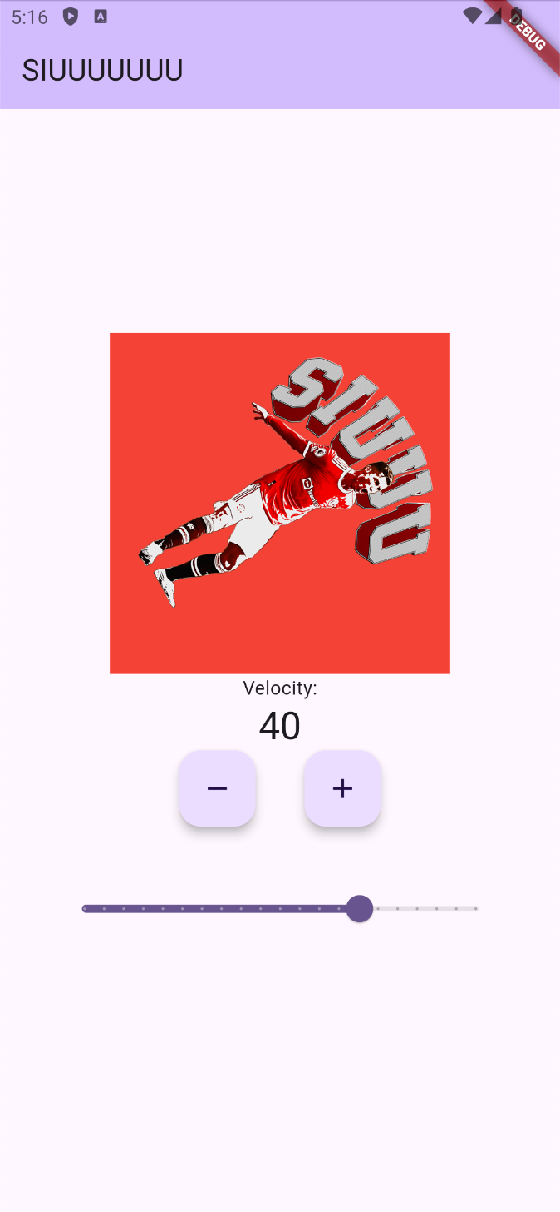
SIUUUUUU page – Padding & Slider
Add a Slider as the last element on the Column:
Padding( padding: const EdgeInsets.all(36.0), child: Slider( min: -10.0, max: 10.0, divisions: 20, value: _value, onChanged: (value) { setState(() { _value = value; }); }, ), ),
'${_value.toInt() * 10}',

Slide 31
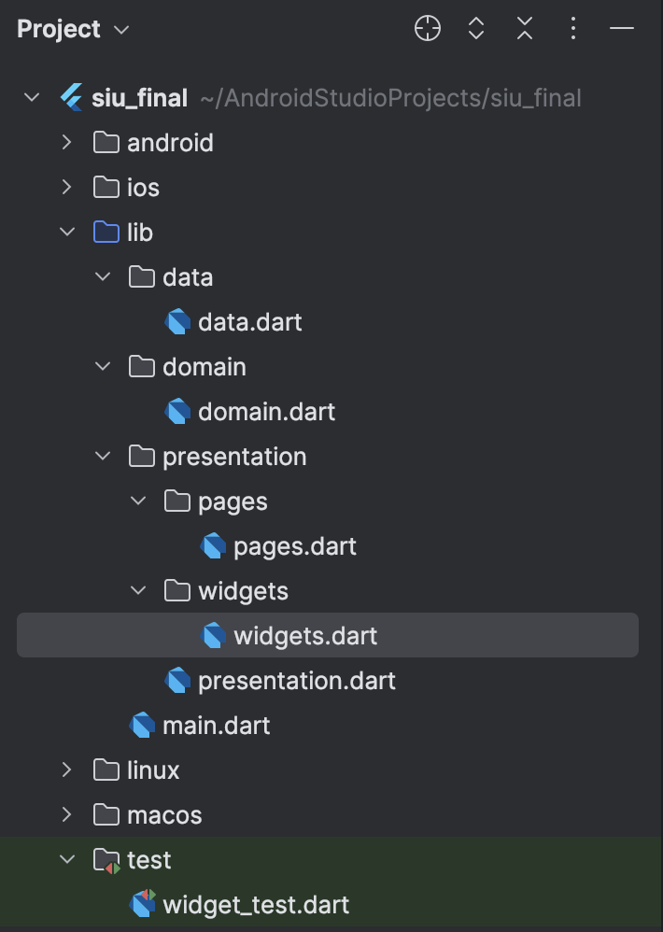
Clean Architecture – Starter kit
Important:
-Separation concern
-SOLID principles
-Single Responsibility Principle
-Open/Closed Principle
-Liskov Substitution Principle
-Interface Segregation Principle
-Dependency Inversion Principle
-Barrel files

Slide 32
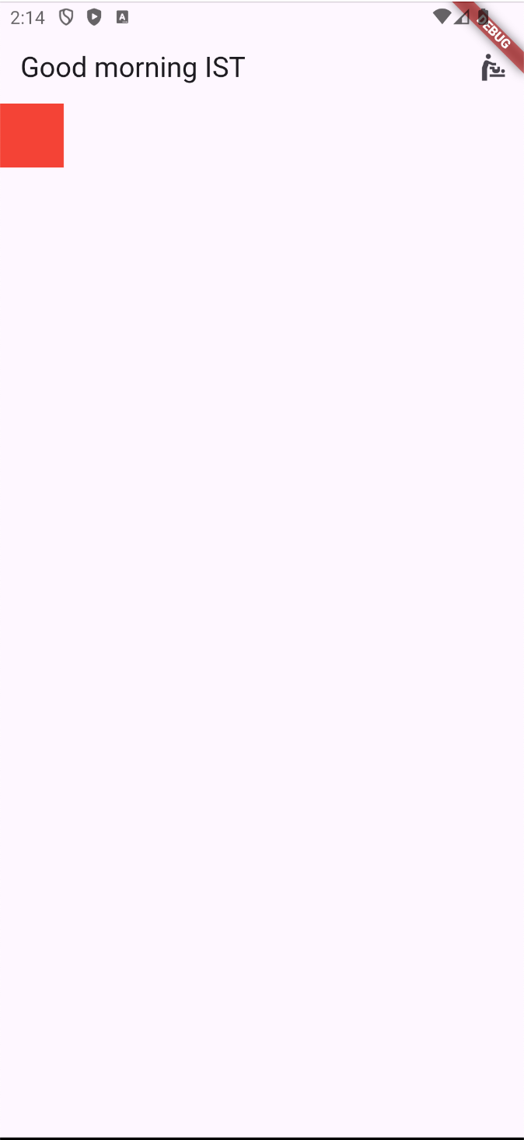
Main page – Navigator
Copy MyHomePage & _MyHomePageState classes to a new Dart file called siu_page.
Rename the class to SiuPage & _SiuPageState, and import the package "material".
Add the siu_page as an export in the pages barrel file. (export 'siu_page.dart';)
Clean the code to have a simple red Container as the body, and change the appBar:
appBar: AppBar( centerTitle: false, title: const Text('Good morning IST'), actions: [ IconButton( icon: const Icon(Icons.baby_changing_station), onPressed: () { Navigator.of(context).push( MaterialPageRoute(builder: (context) => const SiuPage(title: "SIUUUUUUUUU")), ); }, ) ], ),

Slide 33
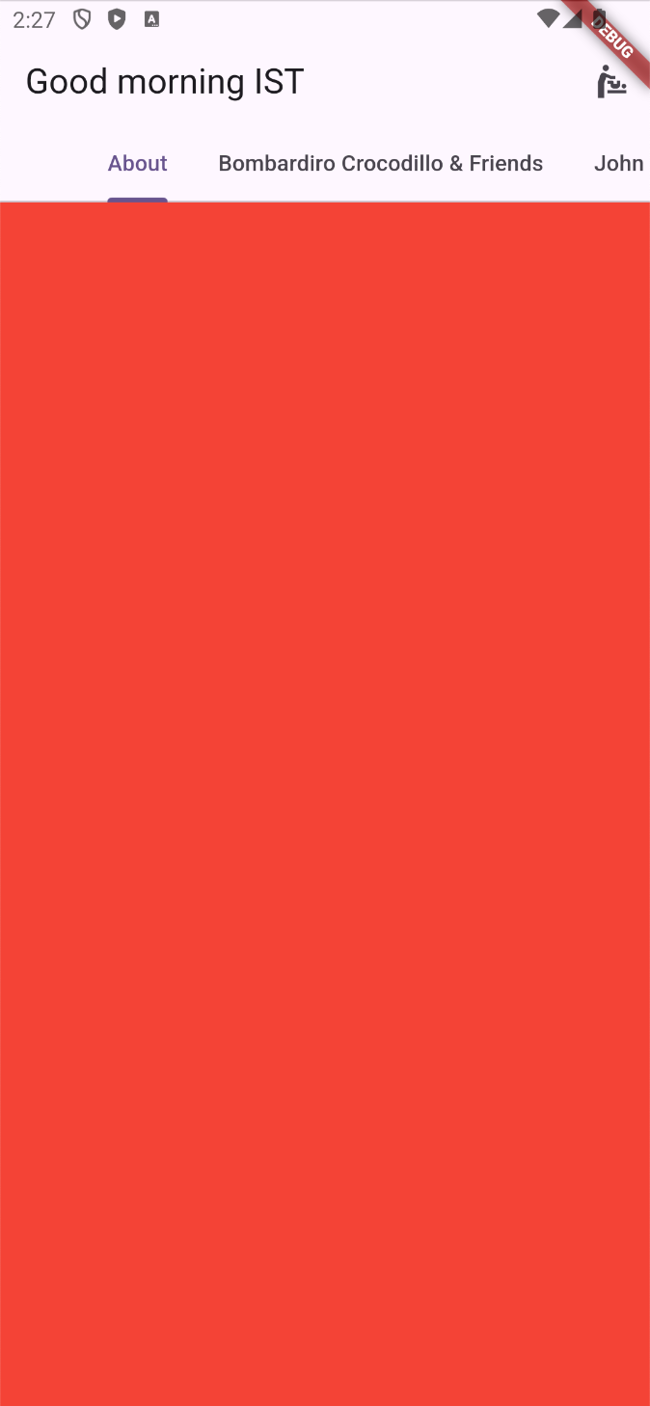
Main page – TabBar
return DefaultTabController( length: 4, child: Scaffold( appBar: AppBar(... bottom: const TabBar( isScrollable: true, tabs: [ Tab(text: 'About'), Tab(text: 'Bombardiro Crocodillo & Friends'), Tab(text: 'John Cena'), Tab(text: 'Links'), ], ), ), body: LayoutBuilder( builder: (context, constraints) => TabBarView( children: [ Container(color: Colors.red), Container(color: Colors.blue), Container(color: Colors.green), Container(color: Colors.yellow), ], ), ), ), );

Slide 34
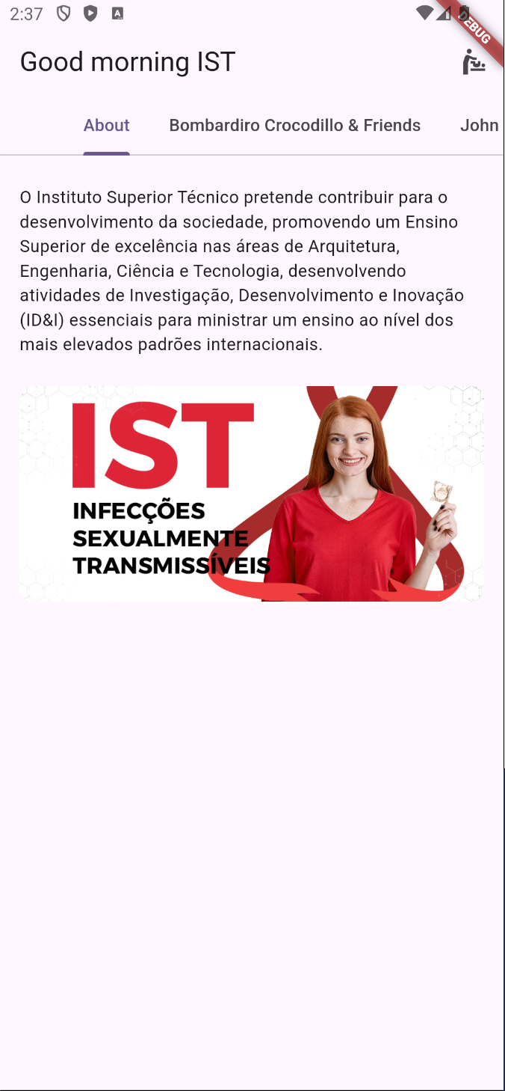
About page – Padding & Borders
Create about_page with a Column and with the 2 children:
const Padding( padding: EdgeInsets.symmetric(horizontal: 16.0, vertical: 24.0), child: Text("O Instituto Superior Técnico pretende contribuir para o desenvolvimento da sociedade, " "promovendo um Ensino Superior de excelência nas áreas de Arquitetura, Engenharia, " "Ciência e Tecnologia, desenvolvendo atividades de Investigação, Desenvolvimento e " "Inovação (ID&I) essenciais para ministrar um ensino ao nível dos mais elevados " "padrões internacionais."), ), Padding( padding: const EdgeInsets.symmetric(horizontal: 16.0), child: InkWell( child: ClipRRect( borderRadius: BorderRadius.circular(10), child: Image.network( 'https://invitro.com.br/wp-content/uploads/2023/02/Base_foto-de-capa.jpg', fit: BoxFit.fitWidth, ), ), ), ),

Slide 35
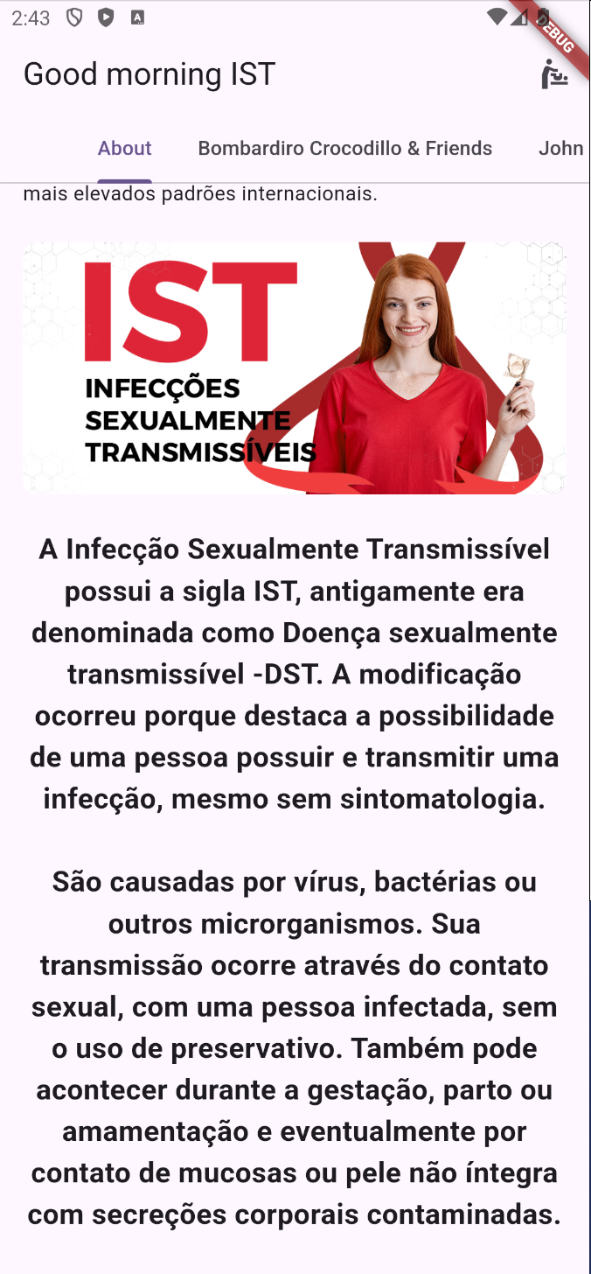
About page – SingleChildScrollView & TextStyles
Wrap the column with a SingleChildScrollView and add 2 more children to the end:
const Padding( padding: EdgeInsets.symmetric(horizontal: 16.0, vertical: 24.0), child: Text( "A Infecção Sexualmente Transmissível possui a sigla IST, antigamente era denominada " "como Doença sexualmente transmissível -DST. A modificação ocorreu porque destaca a " "possibilidade de uma pessoa possuir e transmitir uma infecção, mesmo sem " "sintomatologia.\n\nSão causadas por vírus, bactérias ou outros microrganismos. " "Sua transmissão ocorre através do contato sexual, com uma pessoa infectada, " "sem o uso de preservativo. Também pode acontecer durante " "a gestação, parto ou amamentação e eventualmente por contato de mucosas ou pele não " "íntegra com secreções corporais contaminadas.", textAlign: TextAlign.center, style: TextStyle( fontSize: 20.0, fontWeight: FontWeight.w700, ), ), ), const SizedBox(height: 36),

Slide 36
About page – UrlLauncher
To launch an URL we are going to use an external library. First in the pubspec.yaml we add the ref:
dependencies: flutter: sdk: flutter url_launcher: ^6.0.8
Then in the about_page we add the import and the onTap:
import 'package:url_launcher/url_launcher_string.dart';
onTap: () async { const url = 'https://tecnico.ulisboa.pt/pt/'; if (await canLaunchUrlString(url)) { await launchUrlString(url); } else { throw 'Could not launch $url'; } },
If you try and test it now, it won't work. The reason is due to the need for User Permissions for the "native" part.
For Android, in android>app>src>main>AndroidManifest.xml:
<uses-permission android:name="android.permission.QUERY_ALL_PACKAGES"/>
<intent> <action android:name="android.intent.action.VIEW" /> <data android:scheme="https" /> </intent>
For iOS, in ios>Runner>info.plist:
<key>LSApplicationQueriesSchemes</key> <array> <string>https</string> <string>http</string> </array>

Slide 37
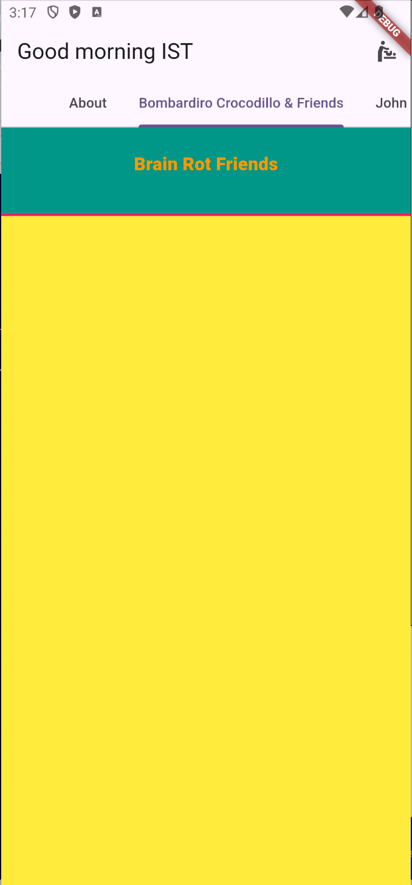
Bombardiro page – Expanded & double.infinity
Create bombardiro_crocodillo_page with a Column and with the 3 children:
Container( color: Colors.teal, width: double.infinity, child: const Padding( padding: EdgeInsets.only(top: 24.0, bottom: 36.0), child: Center( child: Text( "Brain Rot Friends", style: TextStyle( color: Colors.orange, fontWeight: FontWeight.w900, fontSize: 18.0, ), ), ), ), ), Container( color: Colors.pink, height: 3, width: double.infinity, ), Expanded(child: Container(color: Colors.yellow)),

Slide 38
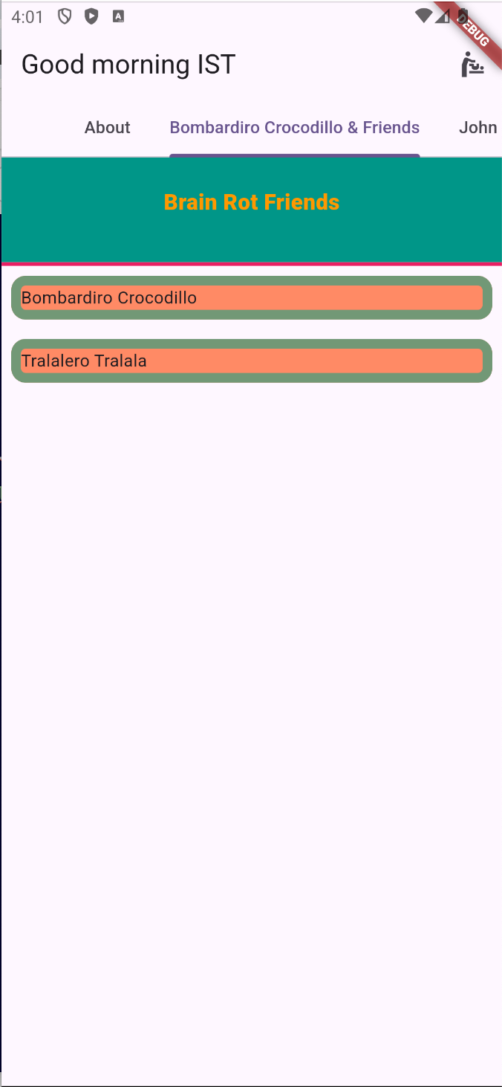
Bombardiro page – ListView.builder
Add a var for brainRotAnimals, and replace the Container with a ListView.builder:
final brainRotAnimals = ["Bombardiro Crocodillo", "Tralalero Tralala"];
Expanded( child: ListView.builder( itemCount: brainRotAnimals.length, itemBuilder: (BuildContext context, int index) { return Padding( padding: const EdgeInsets.all(8.0), child: Container( decoration: BoxDecoration( color: Colors.deepOrange.shade300, border: Border.all( width: 8, color: const Color(0xff729876), ), borderRadius: BorderRadius.circular(12), ), child: Text(brainRotAnimals[index]), ), ); }, ), ),

Slide 39
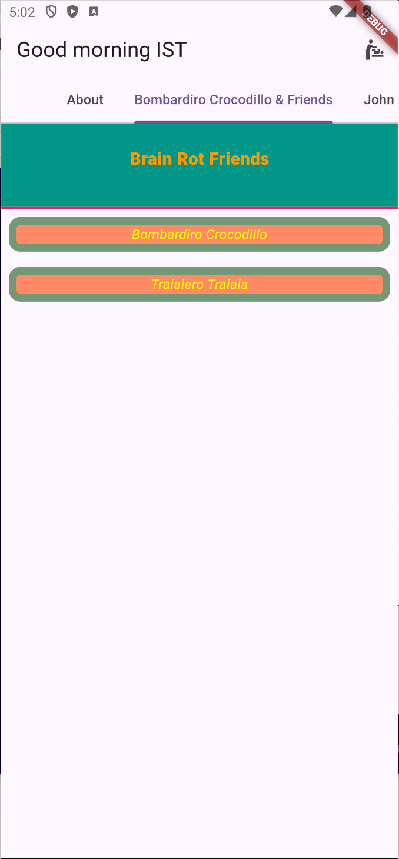
Bombardiro page – Custom Widget
We can create a Widget for the brainRotAnimals:
child: BrainRotAnimalWidget(name: brainRotAnimals[index]),
class BrainRotAnimalWidget extends StatelessWidget { const BrainRotAnimalWidget({ super.key, required this.name, }); final String name; @override Widget build(BuildContext context) { return Column( children: [ Text( name, style: const TextStyle( color: Colors.yellowAccent, fontStyle: FontStyle.italic, ), ), ], ); } }

Slide 40
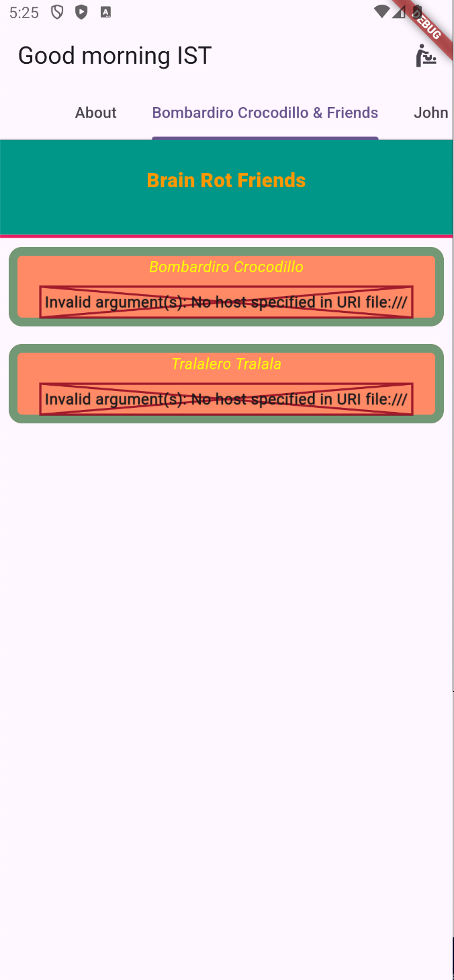
Bombardiro page – Custom Class
Let's create on data a Class for a BrainRotAnimal:
class BrainRotAnimal { BrainRotAnimal({ required this.name, required this.imageUrl, }); String name; String imageUrl; }
Now we can use it on the widget:
const BrainRotAnimalWidget({ super.key, required this.brainRotAnimal, }); final BrainRotAnimal brainRotAnimal;
Add to the end of Column on the Widget:
const SizedBox(height: 8), Image.network(brainRotAnimal.imageUrl),
Change the call on the Page, use:
final brainRotAnimals = [ BrainRotAnimal(name: "Bombardiro Crocodillo", imageUrl: ""), BrainRotAnimal(name: "Tralalero Tralala", imageUrl: "") ];

Slide 41
Bombardiro page – Repository
Now we can create a Repository from where our data will come:
final _brainRotAnimals = [ BrainRotAnimal( name: "Bombardiro Crocodillo", imageUrl: "https://static.wikia.nocookie.net/brainrotnew/images/1/10/Bombardiro_Crocodilo.jpg/revision/latest/scale-to-width/360?cb=20250417102447", ), BrainRotAnimal( name: "Tralalero Tralala", imageUrl: "https://static.wikia.nocookie.net/brainrotnew/images/a/ac/Tralalero_tralala.jpg/revision/latest?cb=20250321131418", ), BrainRotAnimal( name: "Trippi Troppi", imageUrl: "https://static.wikia.nocookie.net/brainrotnew/images/1/14/640.jpg/revision/latest?cb=20250416053733", ), BrainRotAnimal( name: "Brr Brr Patapim", imageUrl: "https://static.wikia.nocookie.net/brainrotnew/images/f/f7/Brr_Brr_Patapim.png/revision/latest?cb=20250326180223", ), BrainRotAnimal( name: "Garamaraman dan Madudungdung tak tuntung perkuntung", imageUrl: "https://static.wikia.nocookie.net/brainrotnew/images/e/ed/Garam_dan_mahadu.png/revision/latest?cb=20250429225604", ), ];
class BombardiroFriendsRepository { List<BrainRotAnimal> getBombardiroFriends() => _brainRotAnimals; }

Slide 42
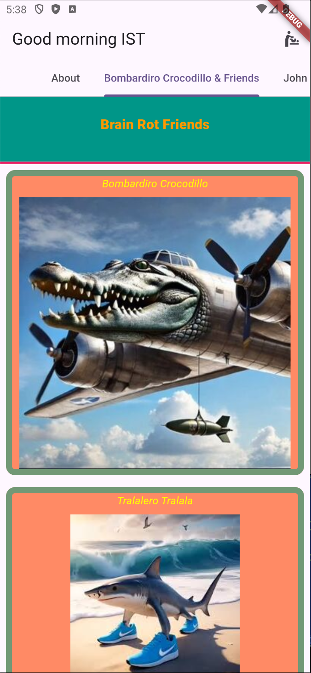
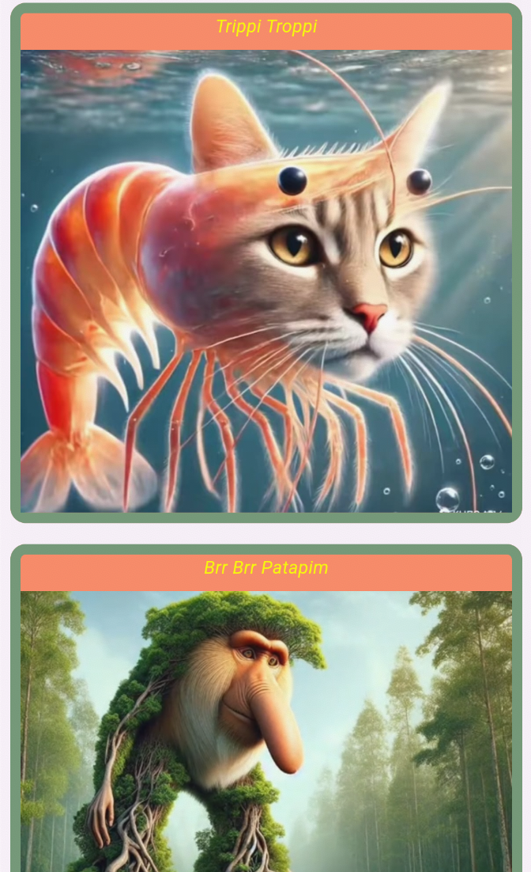
Bombardiro page – Bringing everything together
Now we bring everything together by getting the data from the Repository:
final brainRotAnimals = BombardiroFriendsRepository().getBombardiroFriends();

Slide 43
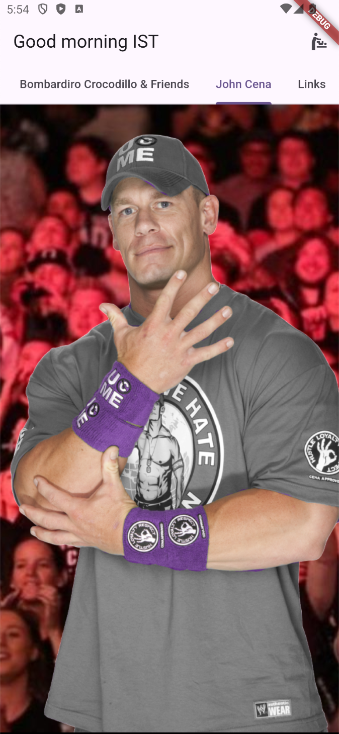
John Cena page – Stack & Positioned
Create a new john_cena_page with a Stack:
return Stack( children: [ Positioned.fill( child: Image.network( 'https://www.pwmania.com/wp-content/uploads/2020/07/fans-crowd.jpg', fit: BoxFit.fitHeight, ), ), Positioned( top: 36, bottom: 0, left: 12, child: Center( child: Image.network( 'https://www.pngall.com/wp-content/uploads/2016/03/John-Cena-U-Cant-See-Me-PNG.png', ), ), ), ], );

Slide 44
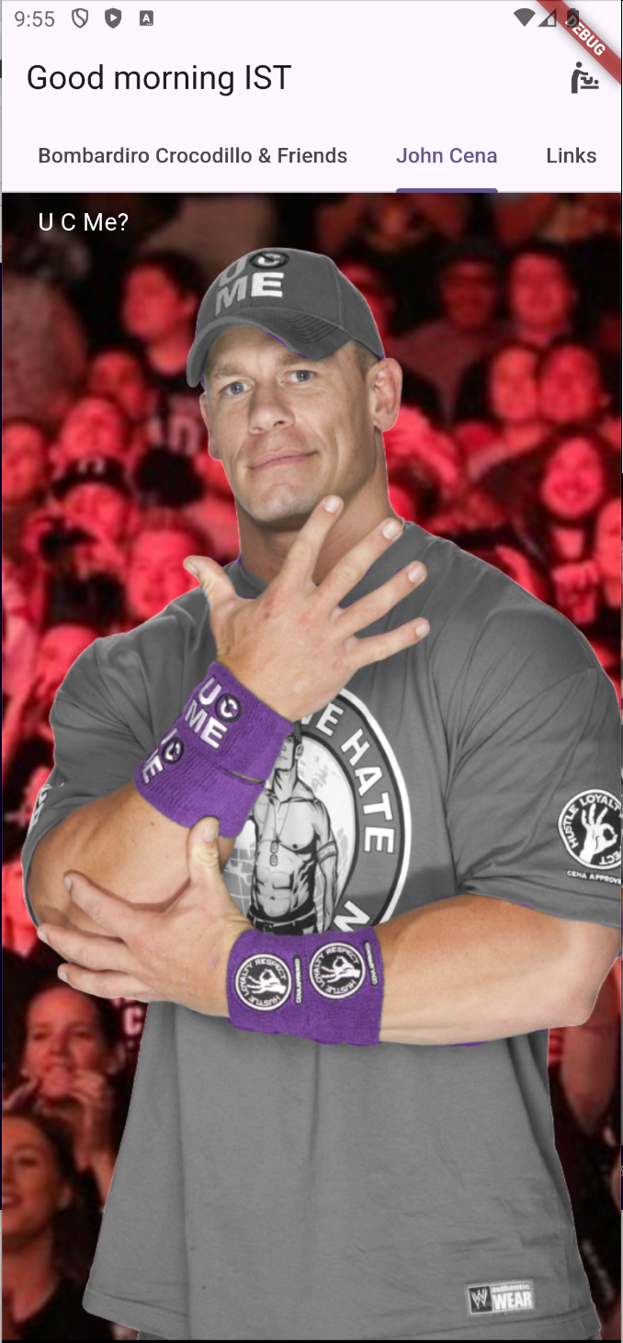
John Cena page – Layout Widgets in Stacks
Add a Column in the Stack:
Positioned( top: 8, left: 8, right: 0, child: Column( mainAxisAlignment: MainAxisAlignment.start, crossAxisAlignment: CrossAxisAlignment.start, children: [ const Padding( padding: EdgeInsets.only(left: 16.0), child: Text( "U C Me?", style: TextStyle( color: Colors.white, fontSize: 16, ), ), ), ], ), ),

Slide 45

John Cena page – ListTile & Radio
Add to the Column:
ListTile( title: const Text( 'True', style: TextStyle(color: Colors.white), ), contentPadding: const EdgeInsets.only(left: 0.0, right: 0.0), visualDensity: const VisualDensity(horizontal: -4, vertical: -4), horizontalTitleGap: 0.0, leading: Radio( value: true, groupValue: selectedOption, activeColor: Colors.red, onChanged: (value) { setState(() { selectedOption = value; opacityLevel = 0.0; print("Button value: $value"); }); }, ), ),
Add another ListTile with blue color, label 'False' and opacityLevel = 1.0.
Add the variables:
bool? selectedOption = false; double opacityLevel = 1.0;

Slide 46
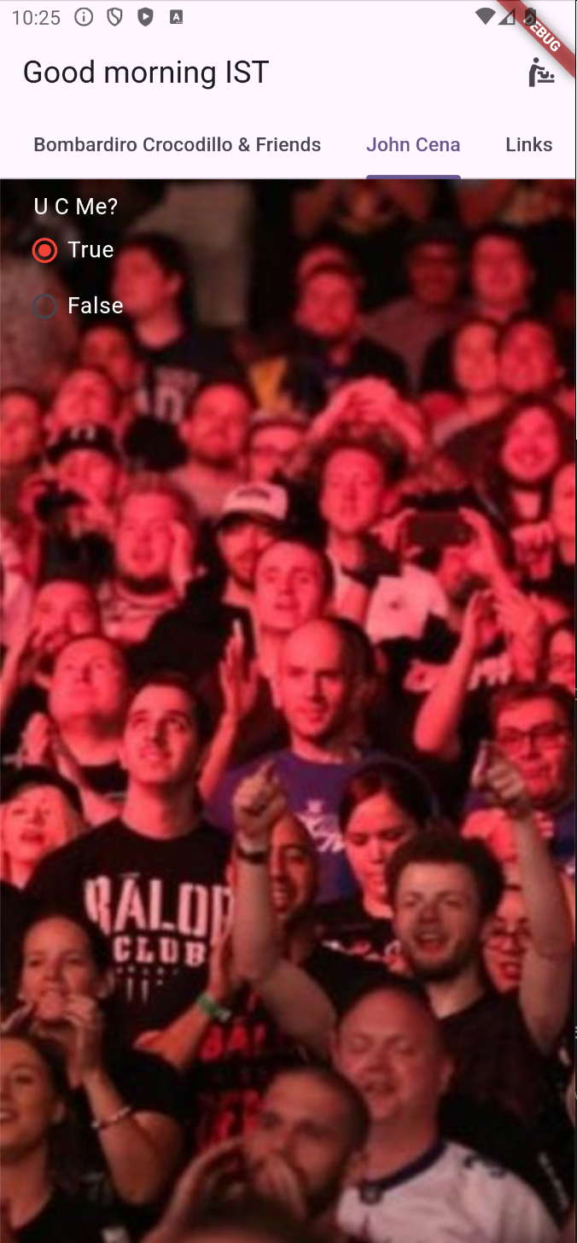
John Cena page – AnimatedOpacity
Wrap the Image with an AnimatedOpacity widget:
Positioned( top: 36, bottom: 0, left: 12, child: Center( child: AnimatedOpacity( opacity: opacityLevel, duration: const Duration(seconds: 1), child: Image.network( 'https://www.pngall.com/wp-content/uploads/2016/03/John-Cena-U-Cant-See-Me-PNG.png', ), ), ), ),

Slide 47
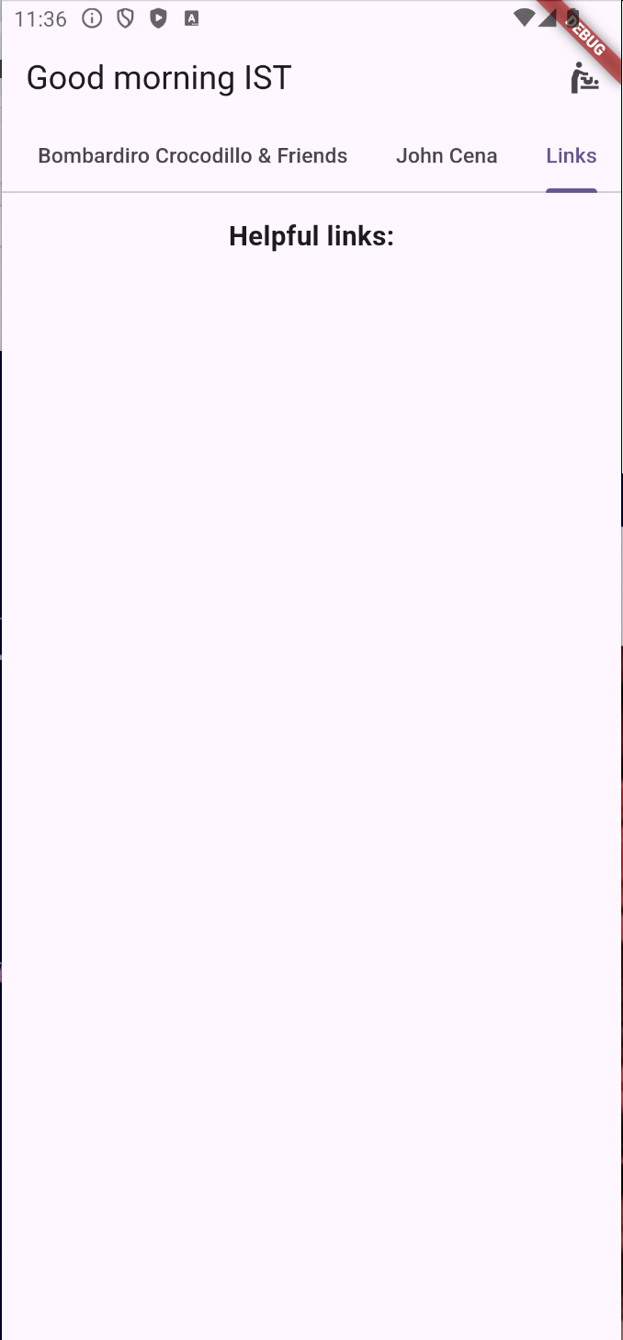
Links page – Final wrap-up
Add the library Linkify to the pubspec.yaml (flutter_linkify: ^6.0.0)
return Column( children: [ const Padding( padding: EdgeInsets.symmetric(vertical: 16.0), child: Text( "Helpful links:", style: TextStyle(fontSize: 18, fontWeight: FontWeight.bold), ), ), ], );
final links = [ 'Flutter main page - https://flutter.dev/', 'Widgets - https://docs.flutter.dev/ui/widgets', 'Basic widgets - https://docs.flutter.dev/ui/widgets/basics', 'Flutter development - https://flutter.dev/development', 'Learning resources - https://docs.flutter.dev/reference/learning-resources', 'Flutter Repo - https://github.com/flutter/flutter', 'Package Repo - https://pub.dev/', 'Showcase BMW - https://flutter.dev/showcase/bmw', 'BMW Tech Repo - https://github.com/bmw-tech', 'Join us @CTW - https://join.criticaltechworks.com/jobs/5382460-flutter-craftsman' ];

Slide 48
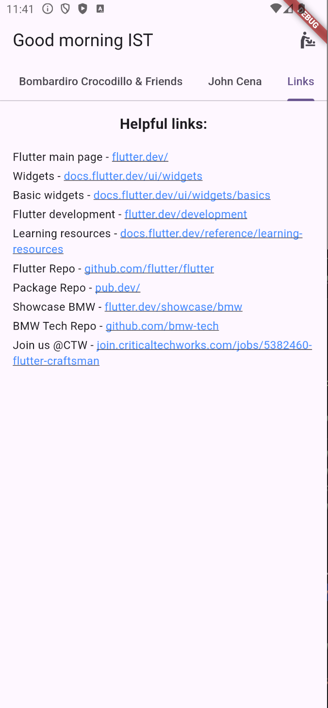
Links page – Wiring everything
Now just add the Linkify widget:
Expanded( child: ListView.builder( itemCount: links.length, itemBuilder: (BuildContext context, int index) { return Padding( padding: const EdgeInsets.symmetric(horizontal: 16.0, vertical: 2.0), child: Linkify( onOpen: (link) async { if (await canLaunchUrlString(link.url)) { await launchUrlString(link.url); } else { throw 'Could not launch $link'; } }, text: links[index], ), ); }, ), ),

Slide 49
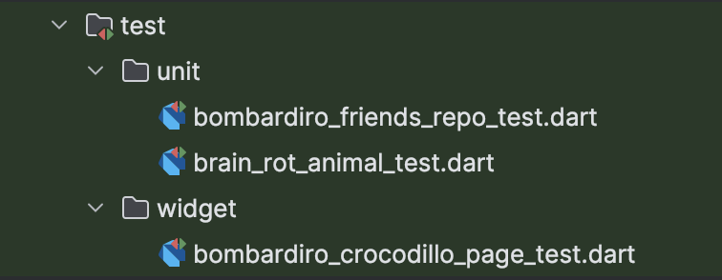
Tests – A new hope
Important:
-Unit & Widget tests
-Why? What for?
-Commands
-CI/CD - Pipelines
-Code Coverage
-Branch Coverage

Slide 50
BrainRotAnimal test – Expect
import 'package:flutter_test/flutter_test.dart'; import 'package:siu_final/data/data.dart'; void main() { testWidgets('Class creates animal correctly test', (WidgetTester tester) async { final brainRotAnimal = BrainRotAnimal(name: "Bombardiro Crocodillo", imageUrl: "mockImageUrl"); expect(brainRotAnimal.name, "Bombardiro Crocodillo"); expect(brainRotAnimal.imageUrl, "mockImageUrl"); }); }

Slide 51
BombardiroFriendsRepo test – SetUp & late
import 'package:flutter_test/flutter_test.dart'; import 'package:siu_final/data/brain_rot_animal.dart'; import 'package:siu_final/domain/bombardiro_friends_repo.dart'; void main() { late List<BrainRotAnimal> brainRotAnimals; setUp(() { brainRotAnimals = BombardiroFriendsRepository().getBombardiroFriends(); }); testWidgets('Repo has the correct data test', (WidgetTester tester) async { expect(brainRotAnimals[0].name, "Bombardiro Crocodillo"); expect(brainRotAnimals.length, 5); }); }

Slide 52
BombardiroCrocodilloPage test – Find.by & pumpWidget
void main() { setUpAll(() => HttpOverrides.global = null); group('Bombardiro Crocodillo Page', () { testWidgets('is created correctly test', (WidgetTester tester) async { await tester.pumpWidget(const MaterialApp(home: BombardiroCrocodilloPage())); await tester.pumpAndSettle(); final bombardiroFinder = find.byWidgetPredicate( (widget) => widget is BrainRotAnimalWidget && widget.brainRotAnimal.name == "Bombardiro Crocodillo", ); final tungTungTungTungTungSahurFinder = find.byWidgetPredicate( (widget) => widget is BrainRotAnimalWidget && widget.brainRotAnimal.name == "Tung Tung Tung Tung Tung Sahur", ); final titleFinder = find.byWidgetPredicate( (widget) => widget is Text && widget.data == "Brain Rot Friends", ); final containerFinder = find.byKey(const Key("titleContainer_bombardiroPage")); expect(titleFinder, findsOneWidget); expect(containerFinder, findsOneWidget); expect(bombardiroFinder, findsOneWidget); expect(tungTungTungTungTungSahurFinder, findsNothing); }); }); }

